Slide 1
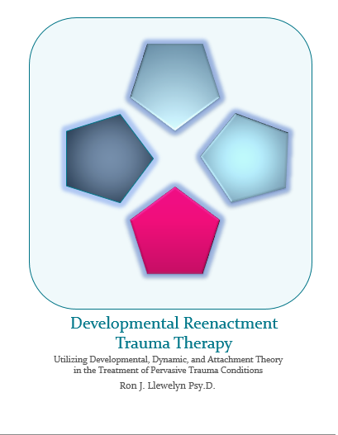
Complex Trauma: Treatment Through the Reenactment of Eriksonian Developmental Stages
Dr. Ron J. Llewelyn
Living waters counseling llc
University of phoenix
www.livingwaterscounselingllc.com

Slide 2
Objectives…
Identify and therapeutically conduct various reenactments that occur between the therapist and the traumatized client
and
Demonstrate effective ways to utilize these reenactments to foster a corrective therapeutic experience for the client

Slide 3
“Recovery can take place only within the context of relationships; it can not occur in isolation. In her renewed connections with other people, the survivor re-creates the psychological faculties that were damaged or deformed by the dramatic experience. These faculties include the basic capacities for trust, autonomy, initiative, competence, identity, and intimacy.” Herman, 1992 p. 1

Slide 4
Stabilization
Education
Remembrance & Mourning
Mastery
Reconnection
Joining
Self-Care
Self-Soothing
Trust
Safety
Integration
Identity
Giving Back
Boundaries

Slide 5
Stabilization
Trust vs. Mistrust
Autonomy vs. Shame & Doubt
Initiative vs. Guilt
Remembering & Mourning
Initiative vs. Guilt
Industry vs. Inferiority
Identity vs. Role Confusion
Intimacy vs. Isolation
Reconnection
Intimacy vs. Isolation
Generativity vs. Stagnation
Integrity vs. Despair

Slide 6
DRTT Essentials
DRTT Essentials
The slower you go, the faster you get there.
We are working with people not a diagnosis
Symptoms and behaviors often have purpose and meaning
Although we are trying to reenact early childhood development, we do NOT treat the client as a child.

Slide 7
Five Principles of DRTT
Five Principles of DRTT
1. Micro vs. Macro Psychosocial Development
2. Psychosocial Unfolding in the
3-tiered model
3. Reenactments occur through Psychodynamic and Attachment means.

Slide 8
Five Principles of DRTT
Five Principles of DRTT
4. Reenactments can lead to Corrective Therapeutic Experiences (CTE) and prepare the client for work in the next stage.
5. Identifying the Corrective Ratio, leads to better understanding of the transference.

Slide 9
DRTT Cautions
Cautions
The Law of Silence
The Power of Transference
The Adoption of Identity
The “I told you so,” Problem.
Jumping into the deep end

Slide 10
Starting the Stabilization Process

Slide 11
Stage 1: Stabilization
Education
Self-Soothing
Self-Care
Trust
Safety
Boundaries

Slide 12
http://www.traumacenter.org/products/products_landing.php
http://www.traumacenter.org/products/pdf_files/DESNOS.pdf
Herman, J. L. (2015). Trauma and recovery. New York: Basic Books.
Chu, J. A. (2011) Rebuilding Shattered Lives: Treating complex ptsd and dissociative disorders. John wiley & sons, Hoboken, New Jersey.

Slide 13
Amygdala before the Cortex
Freeze Response
Stressful Event
Thalamus
Cortex
Amygdala
Locus Coeruleus
Hypothalamus
Sympathetic NS
Para-Sympathetic NS
Thyroid
Pituitary
Adrenal Medulla
Thyroxin
Adrenaline
Adrenal Cortex
Cortisol
Noradrenalin
Adapted from Preston, O’Neal, & Talaga 2010
Notes:
RON
Helping the Client Understand the Symptoms
Help Client Identify what are the symptoms of trauma
Help Normalize these symptoms by discussing the symptoms functional aspects (defensive nature).
The Neurobiology of the Fight or Flight
The Kindling Effect
NE input to the amygdala determines how strongly a memory trace is laid down.
NE is released from the Locus Coeruleus (pronounced Locus Sorulious) into the Amygdala, enhancing memory storage.
Generalized physiological arousal, can trigger trauma related memories, in turn triggering further NE and physiological arousal; reinforcing the traumatic memory trace.
Neuro-anatomical Correlates
Decreased Hippocampal Volumes.
Increased activation of the Amygdala and related structures.
Abnormal Lateralization (Increased limbic activity in only the right hemisphere; areas most involved with emotional arousal (AKA “the worry circuit”). There is some talk about describing PTSD in the DSM-V as a “Fear Circuitry Disorder.”
It is believed that excessive activation of the Amygdala leads to interference with the Long Term Potentiation of memories in the Hippocampus. As such, memories are stored as affective states, senosorimotor states, somatic sensations, or visual images, but rarely as a coherent whole.
Brocas area (most often in the left hemisphere), responsible for translating personal experiences into communicable language, had significantly reduced activation. Therefore, this explains why clients struggle to connect physiology, emotion, into verbal cognition.
Prefrontal Cortical structures have reduced functioning, or are “disconnected,” from limibic, structures.

Slide 14
Broca’s Area
Right Hemisphere
Notes:
RON

Slide 15
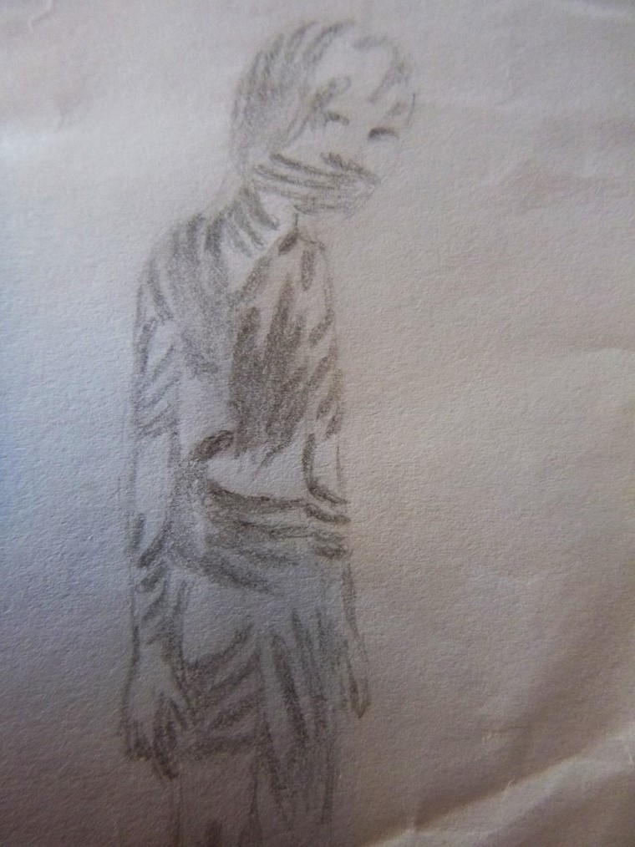

Slide 16
Further Education
Psychological Functioning
Defensive coping
Operant & Classical Conditioning
Cognitive changes
We are vulnerable
The world is predictable & controllable
We merit self-worth
Social Functioning
Safety
Isolation
Trust/Mistrust
Expectations and misperceptions

Slide 17
Physical Well Being
Well Being
Medication
Diet
sleep
Exercise
Reduced Caffeine

Slide 18
Stage One: Self Soothing
Reconditioning
Self-Mutilation?
Breathing
Exercise/Activity
Guided imagery
Journaling/Writing
Art
Music
Nature
Return
Notes:
Wendy (RON MAY ADD INFORMATION)
Dalenberg (2000) identified self mutilation as a possible re-enactment. She gave 5 motivational reasons for re-enactment and 4 non-motivational reasons.
1. The effort toward mastery
2. The seeking of punishment for imagined or actual crimes
3. A dissociated repetition to facilitate integration of the memories or make sense of the trauma
4. Addiction to the arousal state
5. Producing pain to facilitate the avoidance of trauma memories
Non motivational
6. Habit and learning of roles
7. Response to conditioned stimuli
8. Replication attributable to dissociation from internal and external warning signs
9. Biologically based preferences for the known over the unknown in dangerous circumstances.
Why self-mutilation (Brier & Gil, 1998)
71% enhanced feeling of power and control over body
83% self punishment
80% avoidance of painful feelings
77% managing stress
77% decreased negative affect
68% reported a reduction in tension (evidence of compulsion)
58% broke obsession with trauma related memories

Slide 19
Developmental Reenactment Trauma Therapy

Slide 20
Stabilization
Trust vs. Mistrust
Autonomy vs. Shame & Doubt
Initiative vs. Guilt
Remembering & Mourning
Initiative vs. Guilt
Industry vs. Inferiority
Identity vs. Role Confusion
Intimacy vs. Isolation
Reconnection
Intimacy vs. Isolation
Generativity vs. Stagnation
Integrity vs. Despair

Slide 21
Stabilization: Trust Vs. Mistrust
“The attachment system acts as a kind of homeostatic mechanism for modulating anxiety and stress by seeking out an attachment figure for security and protection.”
Bowlby 1978
Notes:
How do we enhance trust and safety in the initial parts of the therapy?

Slide 22
The therapeutic crisis
The Crisis
The Equivalent therapeutic Crisis
can I trust, can I feel safe, or is mistrust warranted?
Do I need to adopt my standard role in relationships (submissive or aggressor)?
Transference, Transference neurosis & Transference Testing
Therapists Role and Efforts
CTE’s
Therapy Contract
Countertransference
Disclosure
Reinforcing Therapeutic Identification (object permanence)
Leading to the Ontogenesis of Hope

Slide 23
Trust vs. Mistrust Skill Building
Experiencing vs. Observing Ego
Distancing
Auxiliary Ego
Reality Testing
Cathartic Interpretation
Working with the projective identification

Slide 24
Stabilization
Trust vs. Mistrust
Autonomy vs. Shame & Doubt
Initiative vs. Guilt
Remembering & Mourning
Initiative vs. Guilt
Industry vs. Inferiority
Identity vs. Role Confusion
Intimacy vs. Isolation
Reconnection
Intimacy vs. Isolation
Generativity vs. Stagnation
Integrity vs. Despair
Autonomy vs. Shame & Doubt: Boundaries

Slide 25
“A sense of self-control without loss of self-esteem is the ontogentic source of confidence…”
(Erikson 1987, p. 602)

Slide 26
Autonomy vs. Shame & Doubt The Therapeutic Crisis
The Crisis
The Equivalent Therapeutic Crisis
The Therapeutic Stance
A dialogue
Flipping the Transference Script
Continue reinforcing therapist identification (to assist in separation)
Working with the projective identification (part 2)

Slide 27
Stabilization
Trust vs. Mistrust
Autonomy vs. Shame & Doubt
Initiative vs. Guilt
Remembering & Mourning
Initiative vs. Guilt
Industry vs. Inferiority
Identity vs. Role Confusion
Intimacy vs. Isolation
Reconnection
Intimacy vs. Isolation
Generativity vs. Stagnation
Integrity vs. Despair
Autonomy vs. Shame & Doubt: Boundaries

Slide 28
“Conscience, however, forever divides the child within himself by establishing an inner voice of self-observation, self-guidance, and self-punishment.”
(Erikson, 1987 p. 604)

Slide 29
Thank You
Ron J. Llewelyn Psy.D.
Office Location 1208 East 3300 South Salt Lake City, Utah 84106 Phone: (801) 921-7854
Web: www.livingwaterscounselingllc.com

