Slide 1
Self-Care
Dr. Ron J. Llewelyn

Slide 2
Has anyone ever felt:
Burnout
Physical & Emotional
Cynicism & Detachment
Ineffectiveness
Notes:
Do any of you ever find yourself:
PHYSICAL/EMOTIONAL SIGNS
Chronically tired
Unable to sleep
Forgetful
Anxious
Depressed
Irritated
Frequently sick
CYNICISM & DETACHMENT
At a loss for enjoyment
Pessimistic
Alone
Detached
INEFFECTIVE
Apathetic/hopeless
Unproductive

Slide 3
Ron’s Sure-Fire Remedy

Slide 4
Ron's surefire remedy…
Remedy

Slide 5
Objectives: Let’s get to self-carin’
Refill & Refuel in healthy ways
Behaviors that promote physical and emotional well-being

Slide 6
What Works? (Poslun & Gall, 2019)
Awareness
Physical Health
Psychological Health
Balance
Social Support

Slide 7
Awareness
Where does your mind go when you daydream?
If your mind were a NETFLIX movie, what would it be about?
If your Family or friends were feeling how you are, what would you try to do for them?

Slide 8
My Favorite Activity: Sleep!!
Apps to measure sleeping
No caffeine after 4:00 pm, or six hours before you plan to go to sleep.
Do not eat big meals after 6:30 pm, or four hours before you plan to go to sleep.
Do not go to bed hungry
Avoid alcohol, even though it is a depressant
Try to exercise in the late afternoon
Do not take naps during the day
Have a regular bedtime routine
Only use your bed for sleeping and…, well, you know.

Slide 9
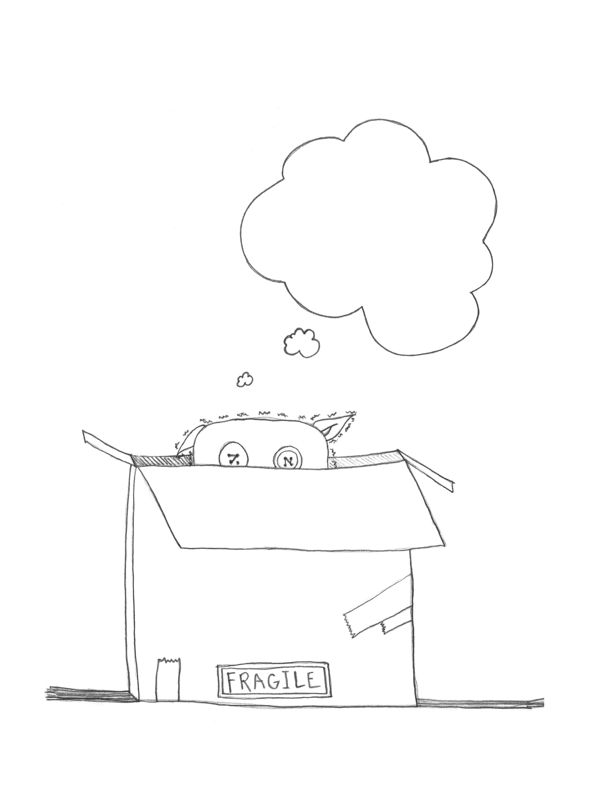
HELP!!

Slide 10
The Neurobiology of the Fight or Flight Response
Freeze Response
Stressful Event
Thalamus
Cortex
Amygdala
Locus Coeruleus
Hypothalamus
Sympathetic NS
Para-Sympathetic NS
Thyroid
Pituitary
Adrenal Medulla
Thyroxin
Hypocapnia
Adrenaline
Adrenal Cortex
Cortisol
Noradrenalin
Adapted from Preston, O’Neal, & Talaga 2010
Notes:
RON
Helping the Client Understand the Symptoms
Help Client Identify what are the symptoms of trauma
Help Normalize these symptoms by discussing the symptoms functional aspects (defensive nature).
The Neurobiology of the Fight or Flight
The Kindling Effect
NE input to the amygdala determines how strongly a memory trace is laid down.
NE is released from the Locus Coeruleus (pronounced Locus Sorulious) into the Amygdala, enhancing memory storage.
Generalized physiological arousal, can trigger trauma related memories, in turn triggering further NE and physiological arousal; reinforcing the traumatic memory trace.
Neuro-anatomical Correlates
Decreased Hippocampal Volumes.
Increased activation of the Amygdala and related structures.
Abnormal Lateralization (Increased limbic activity in only the right hemisphere; areas most involved with emotional arousal (AKA “the worry circuit”). There is some talk about describing PTSD in the DSM-V as a “Fear Circuitry Disorder.”
It is believed that excessive activation of the Amygdala leads to interference with the Long Term Potentiation of memories in the Hippocampus. As such, memories are stored as affective states, senosorimotor states, somatic sensations, or visual images, but rarely as a coherent whole.
Brocas area (most often in the left hemisphere), responsible for translating personal experiences into communicable language, had significantly reduced activation. Therefore, this explains why clients struggle to connect physiology, emotion, into verbal cognition.
Prefrontal Cortical structures have reduced functioning, or are “disconnected,” from limibic, structures.

Slide 11
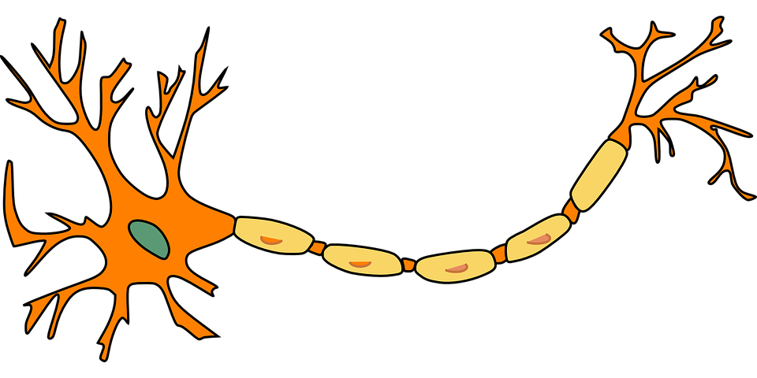
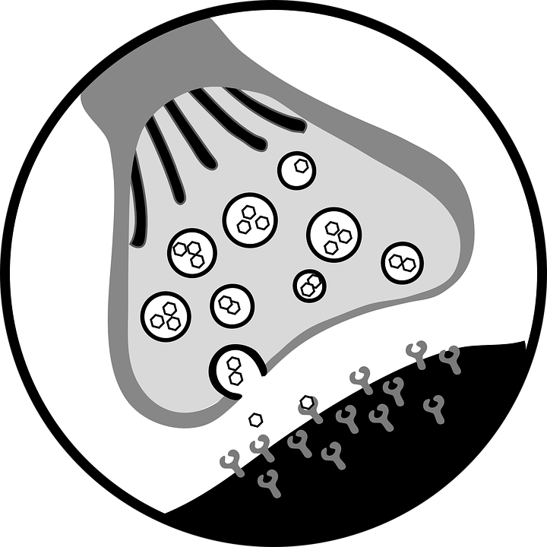
Needing Homeostasis

Slide 12
I paid you how much for you to tell me to breath?
Types of Breath Training
Diaphragmatic Breathing
Coherence Breathing

Slide 13
Psychological Health

Slide 14
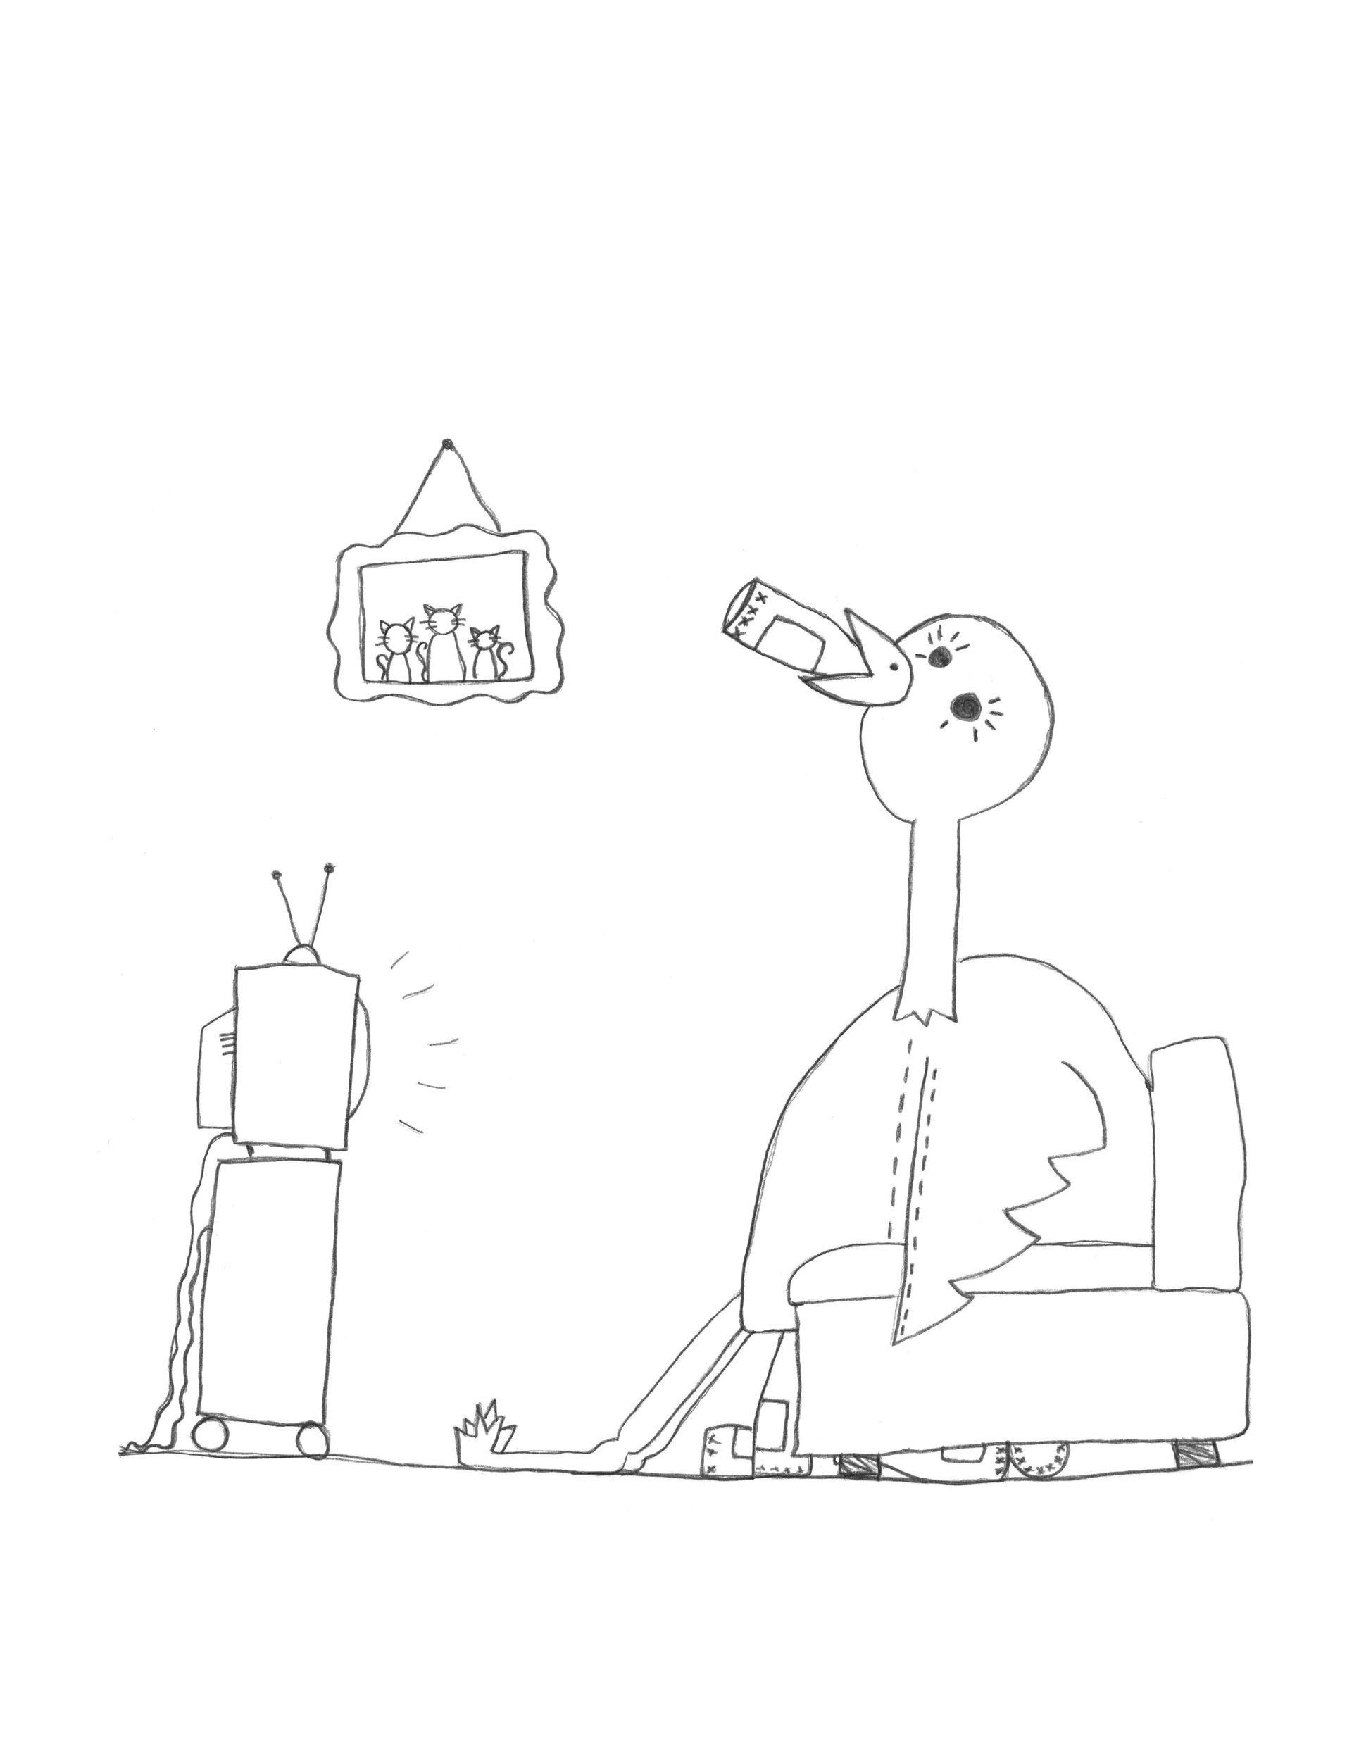
Coping/Adaptation

Slide 15
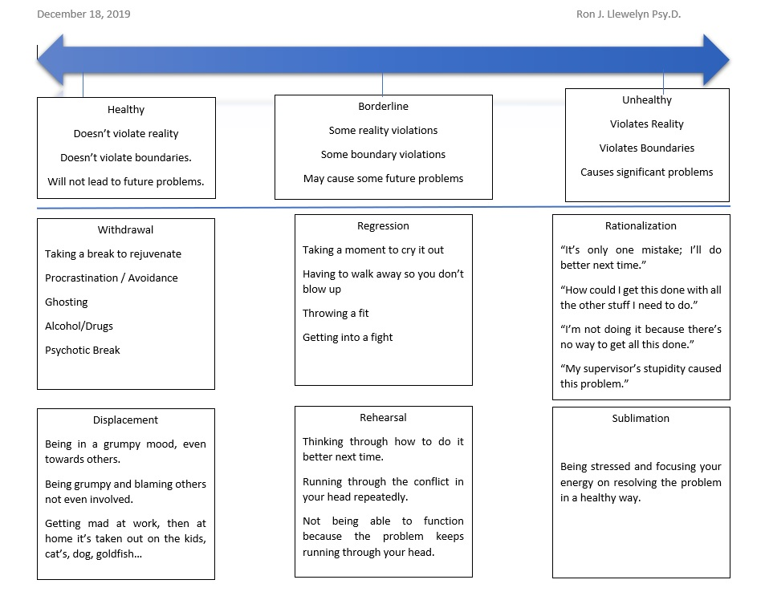
Adaptation

Slide 16
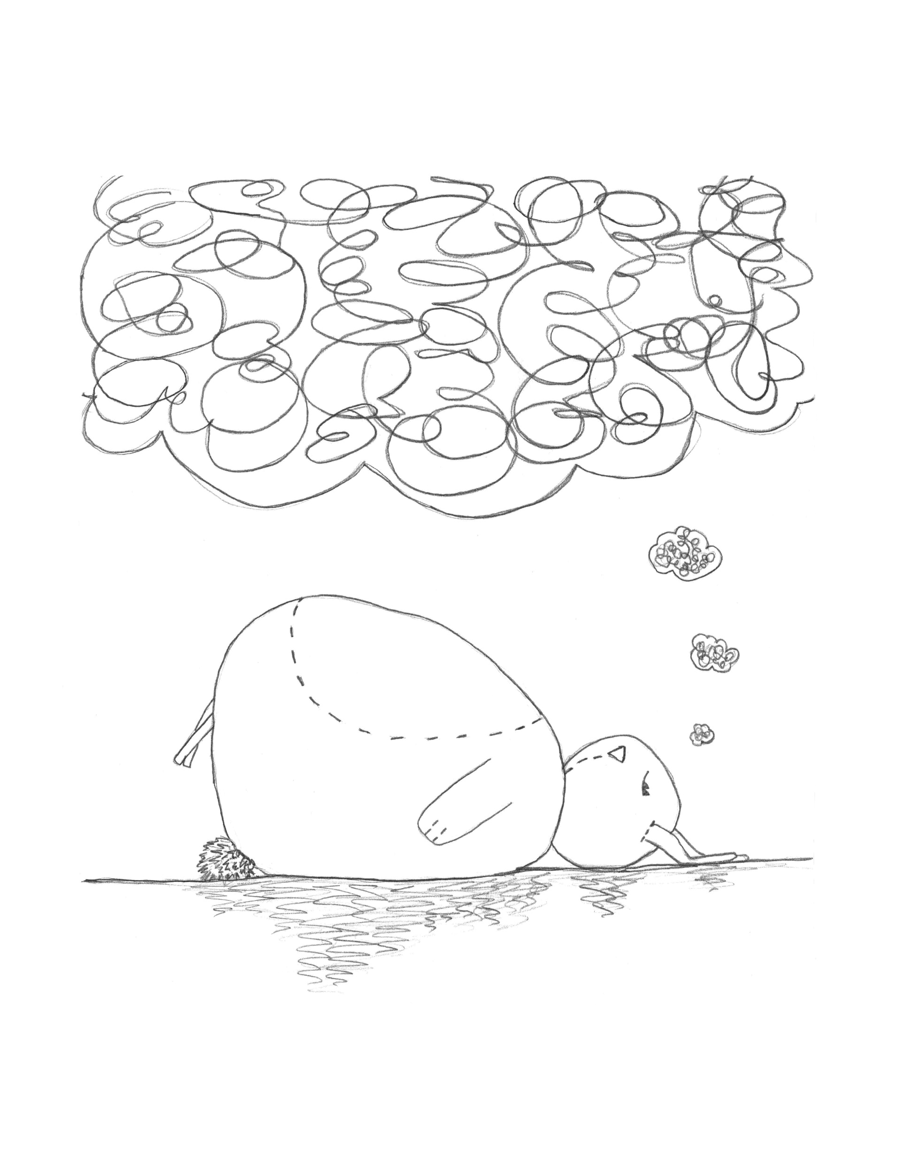
Cognition

Slide 17
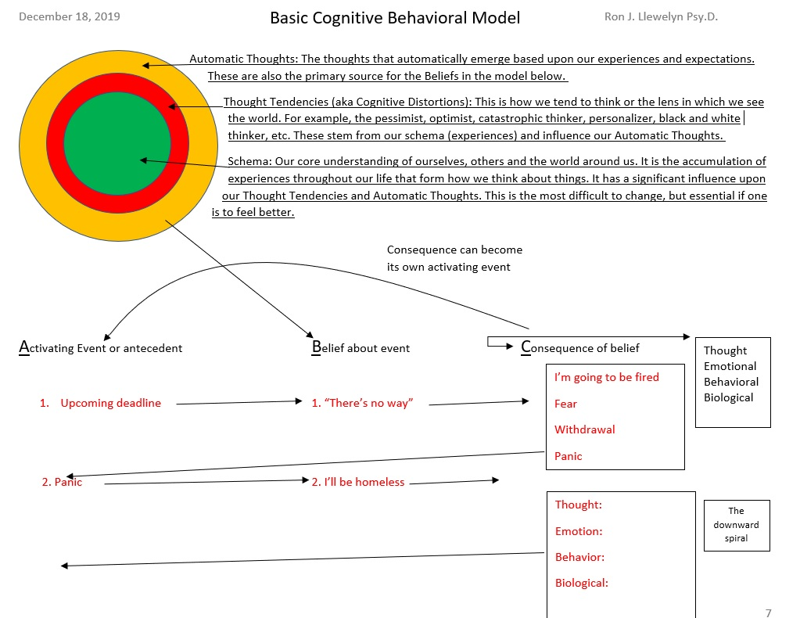

Slide 18
Dispute the Belief
Alternative Belief:
Practice
Feeling: Consequence
Thought
Emotion
Behavior
Biological

Slide 19
Attributional Beliefs Leading to Burnout and Hopelessness
Better
Internal
Specific
Worse
External
Global
Unstable
Stable

Slide 20
Social Support
The Monkey & The Ice cream
Laughing
Getting away from work

Slide 21
Links
www.livingwaterscounselingllc.com
www.dontworryimokay.com

